Slide 1

TOPIC-Libre office Impress
COURSE: CCC
CHAPTER: 05 (Impress)
NIELIT
Presentation By : Shruti dubey

Slide 2
Content
Introduction
Creation of Presentation
Creating a Presentation Using a Template
Creating a Blank Presentation
Inserting & Editing Text on Slides
Inserting and Deleting Slides in a Presentation
Saving a Presentation
Manipulating Slides
Inserting Table
Adding Pictures
Inserting Other Objects
Resizing and Scaling an Object

Slide 3
Content
Creating & using Master Slide
Presentation of Slides
Choosing a Set Up for Presentation
Running a Slide Show
Transition and Slide Timings
Automating a Slide Show
Providing Aesthetics to Slides & Printing
Enhancing Text Presentation
Working with Color and Line Style,
Adding Movie and Sound
Adding Headers, Footers and Notes
Printing Slides and Handouts

Slide 4
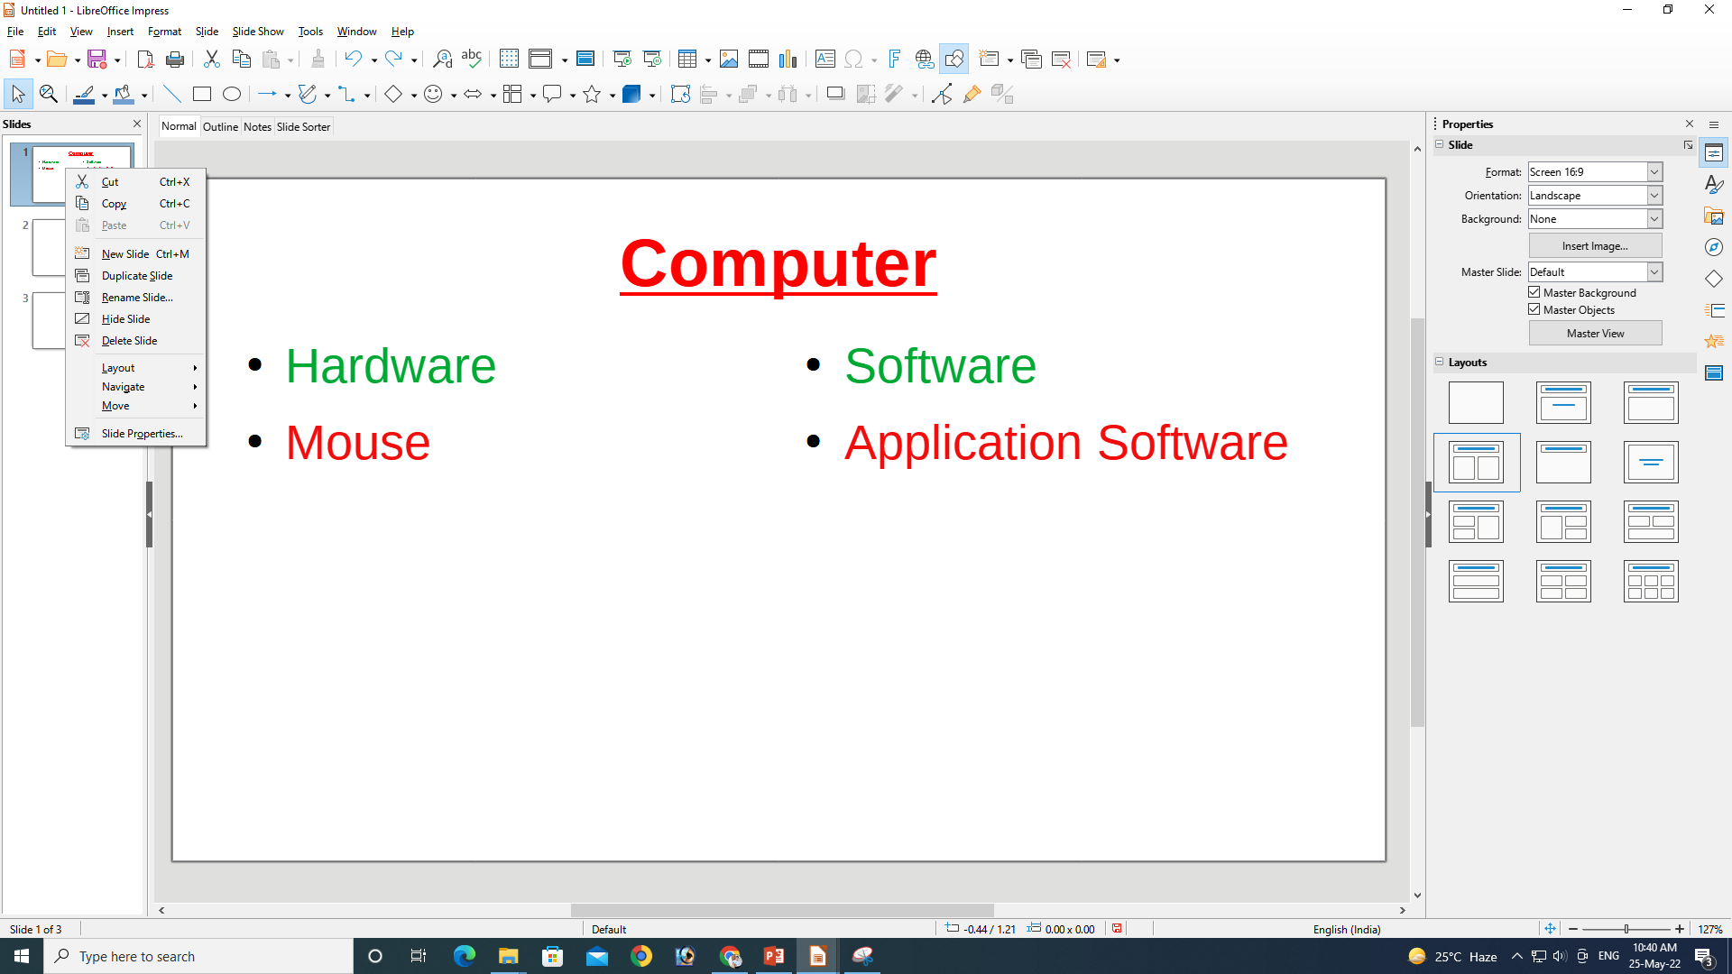
Inserting and Deleting Slides in a Presentation

Slide 5
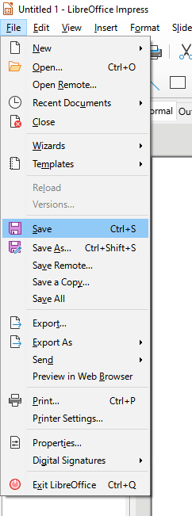
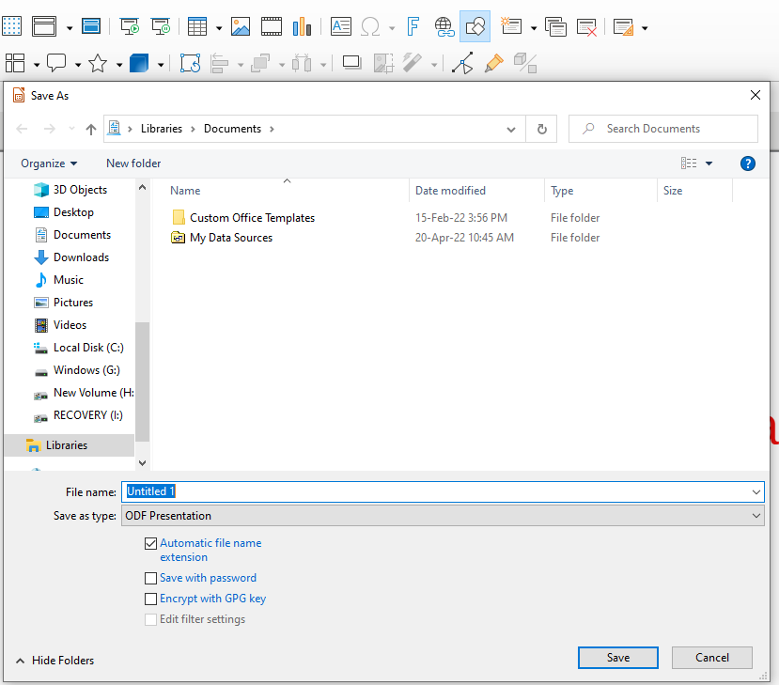
Saving a Presentation

Slide 6
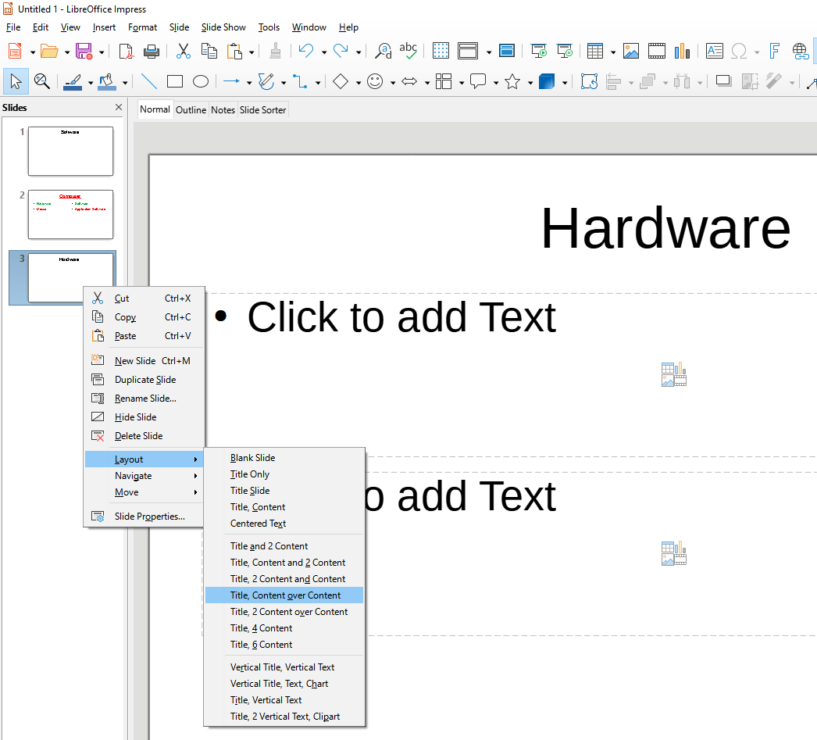
Manipulating Slides

Slide 7
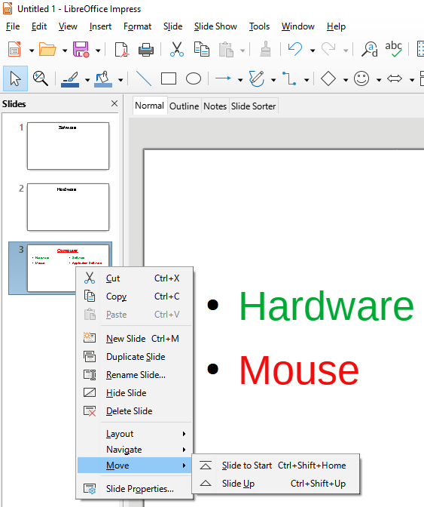
Manipulating Slides

Slide 8
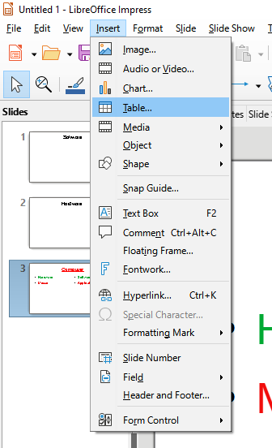
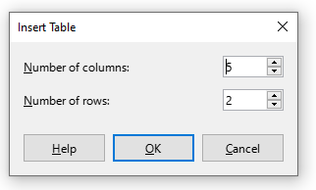
Inserting Table

Slide 9
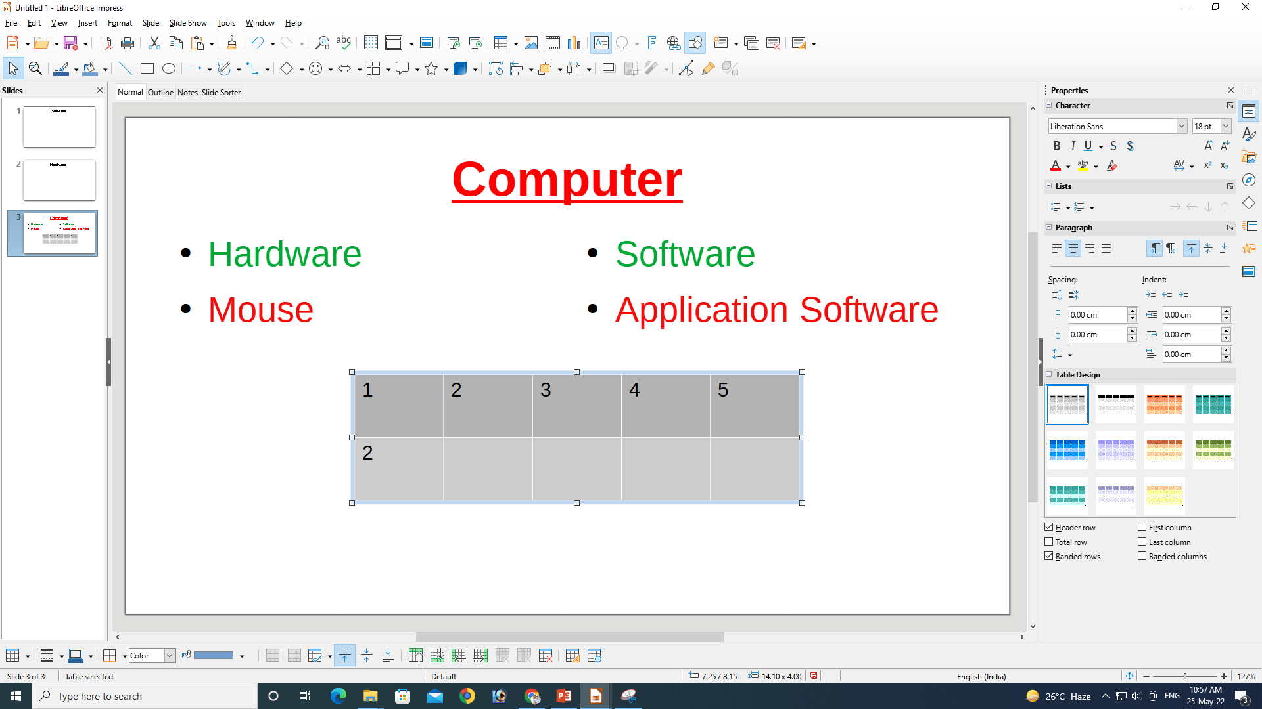
Inserting Table

Slide 10

Adding Pictures

Slide 11
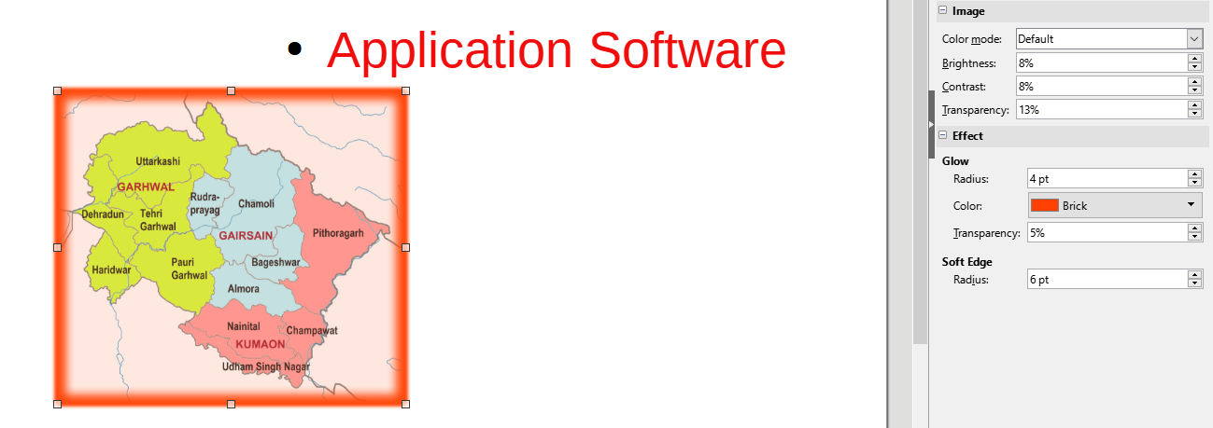
Adding Pictures

Slide 12
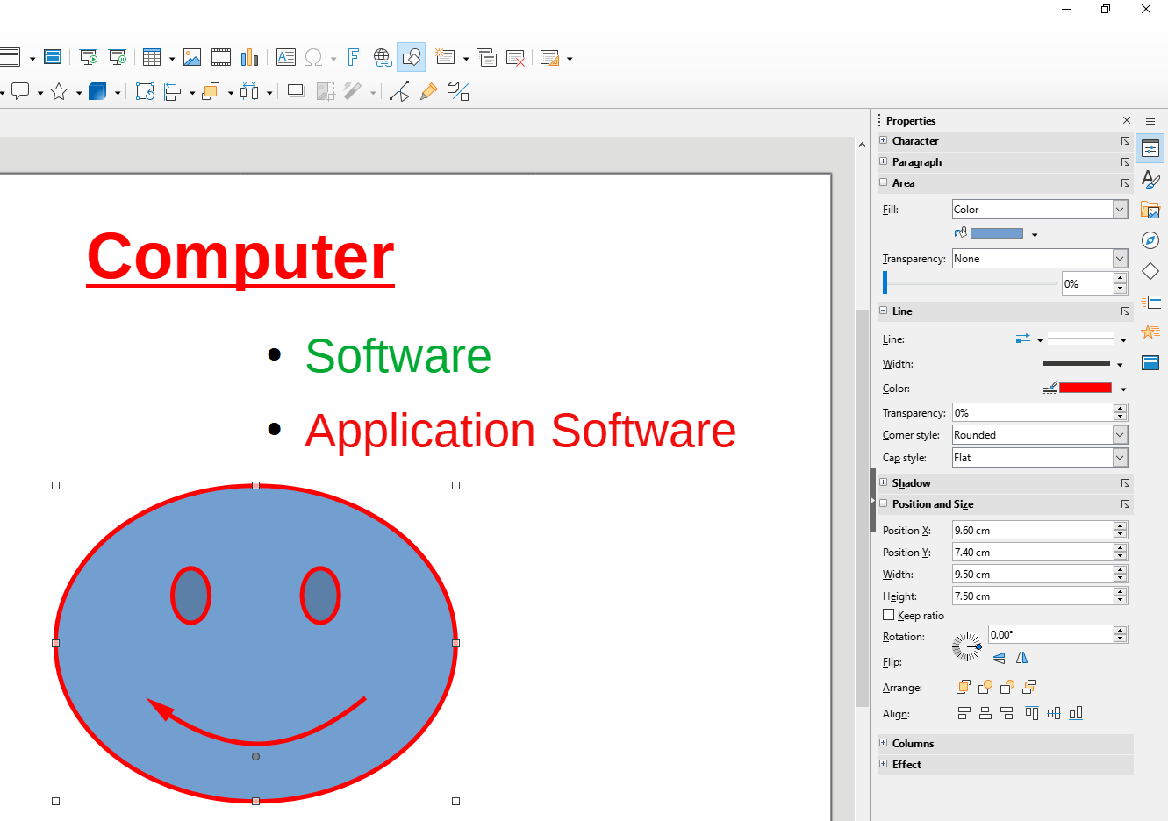
Inserting Other Objects

Slide 13
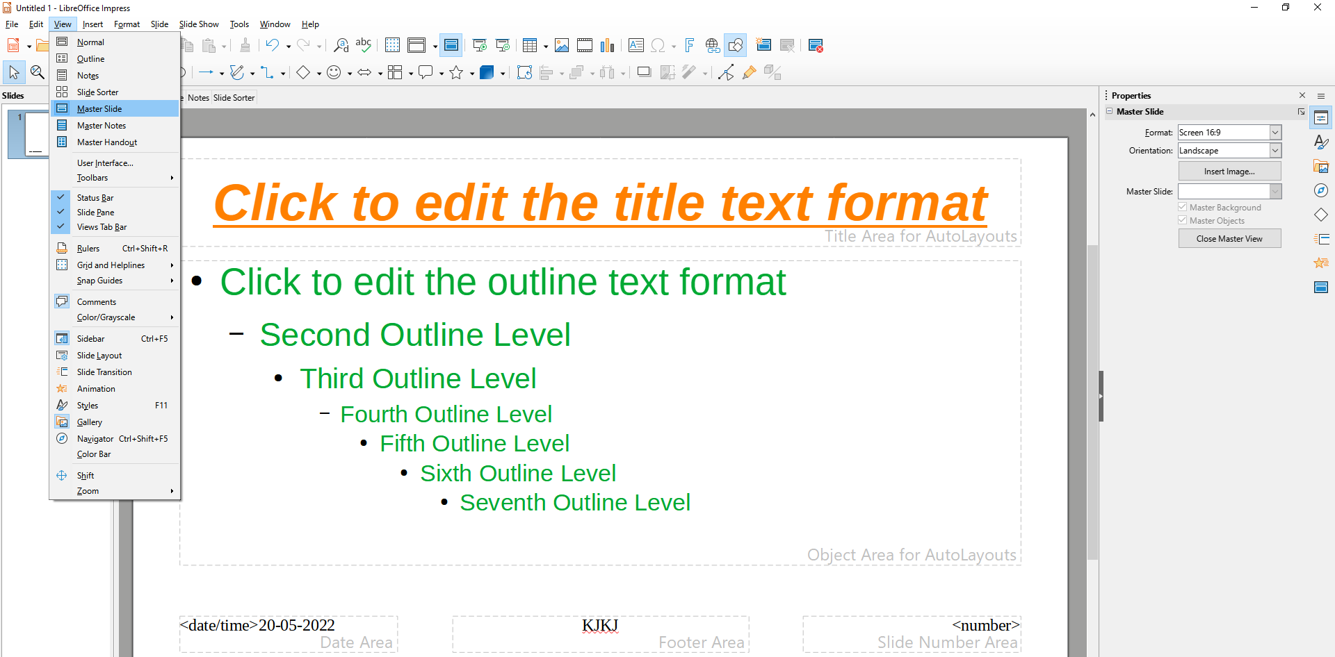
Creating & using Master Slide

Slide 14
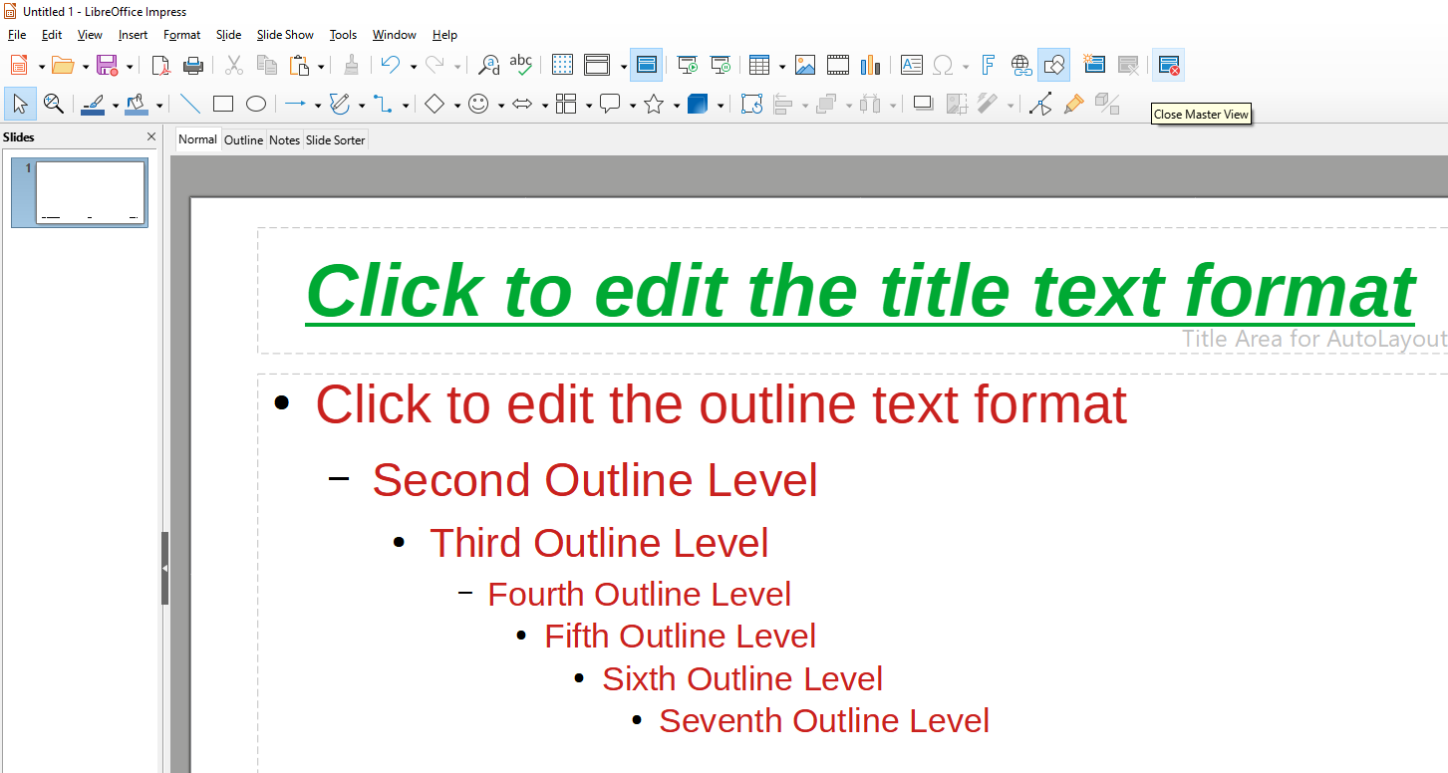
Creating & using Master Slide

Slide 15
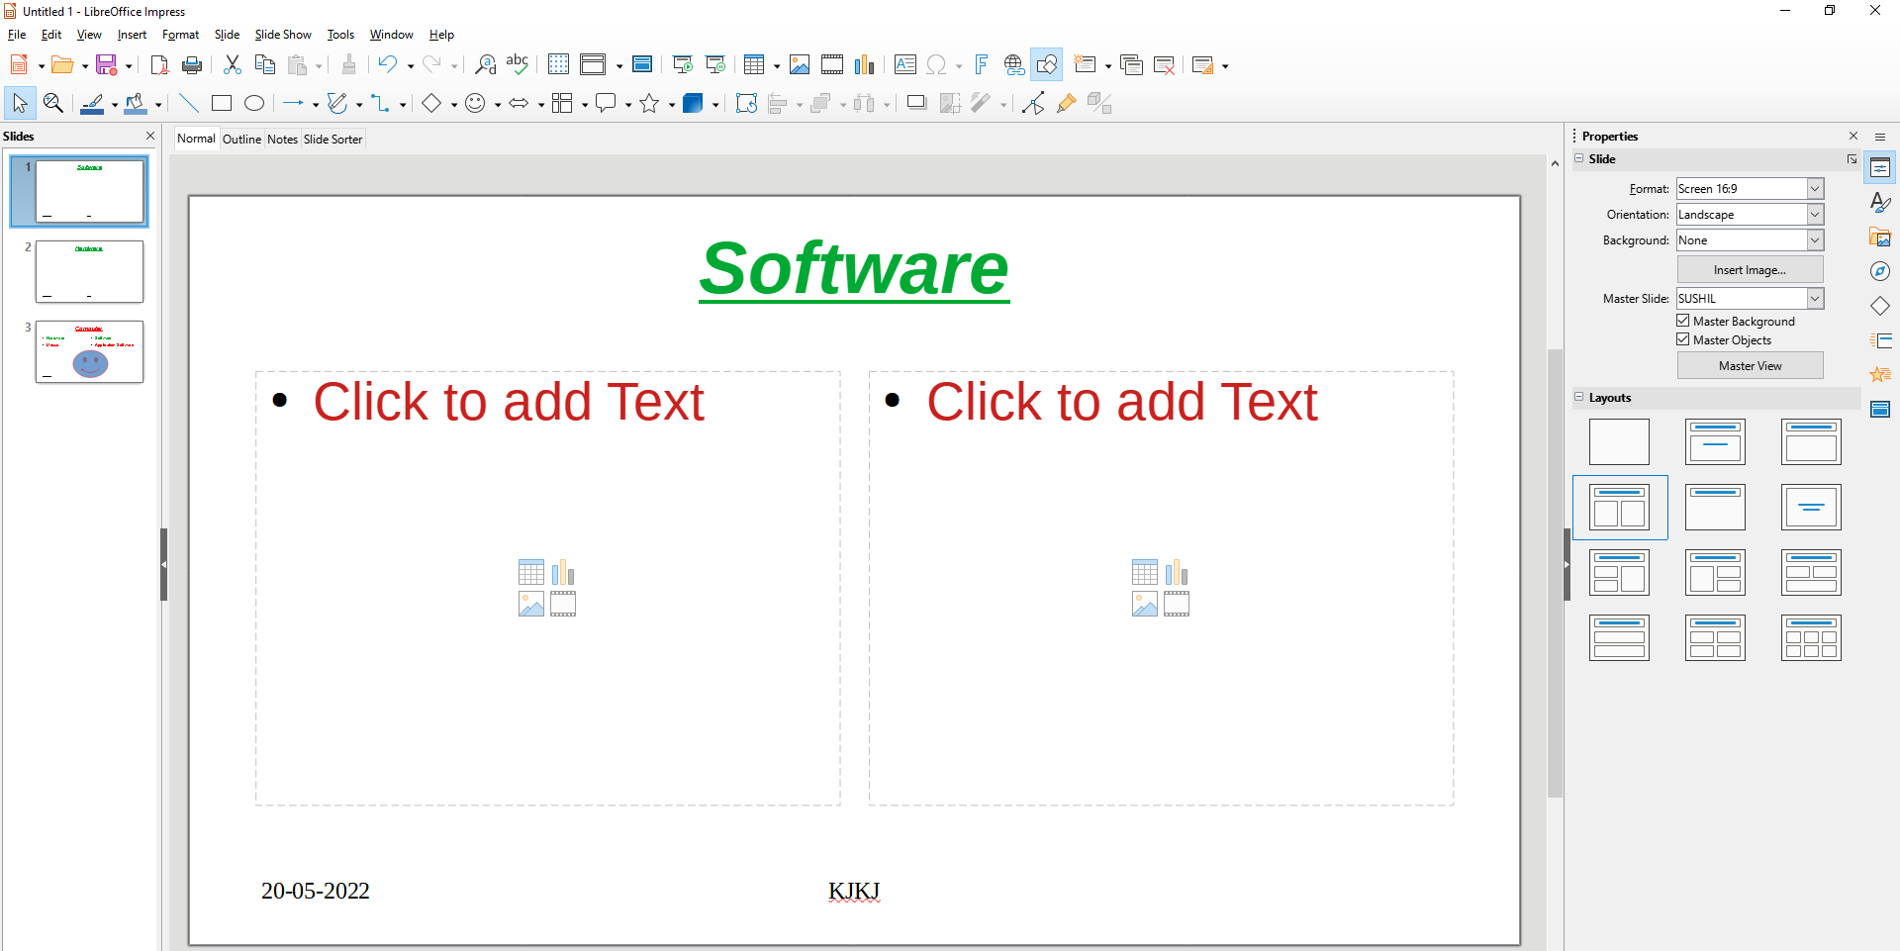
Creating & using Master Slide

Slide 16
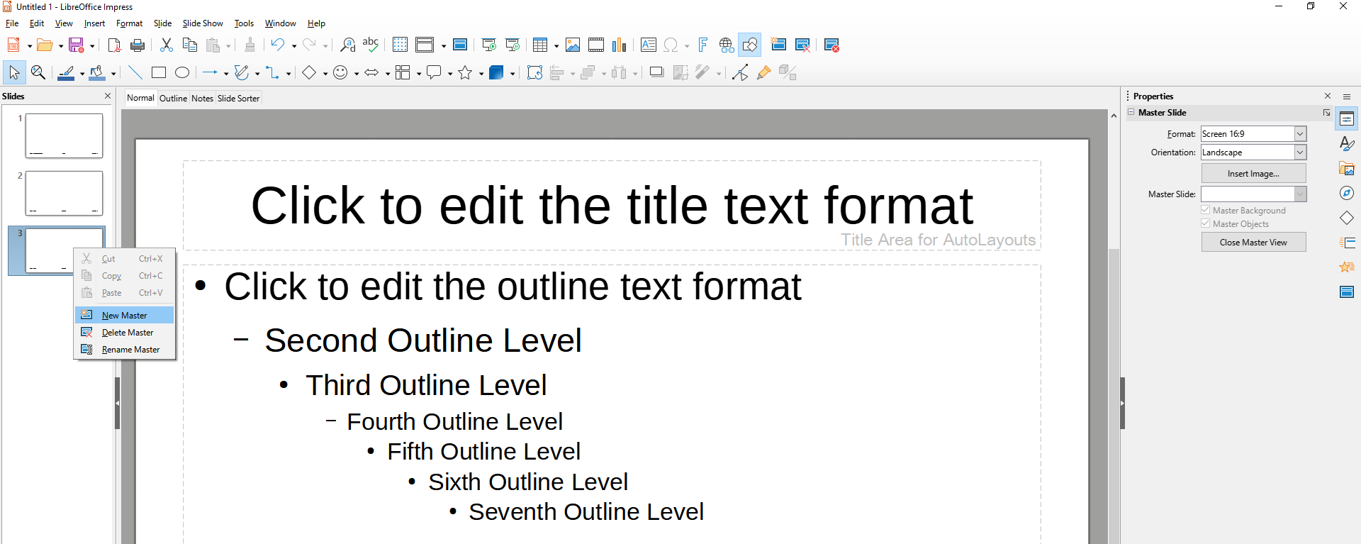
Creating & using Master Slide

Slide 17
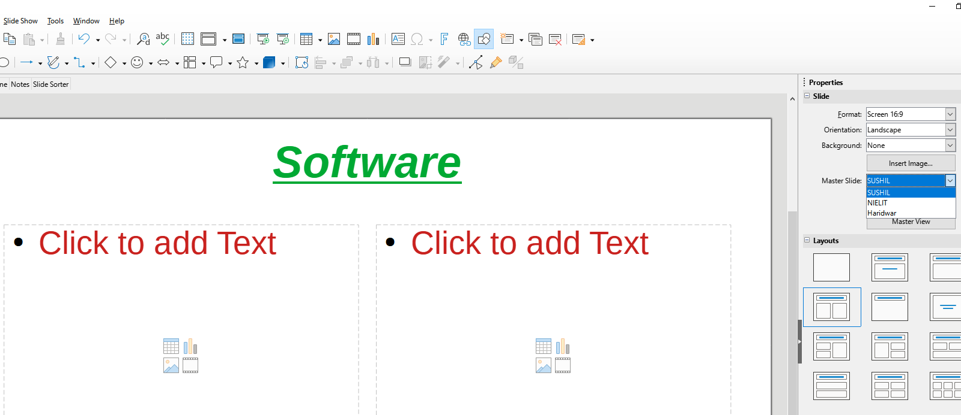
Creating & using Master Slide

Slide 18
Thank You
NIELIT
Presentation By : Shruti Dubey

